Slide 1
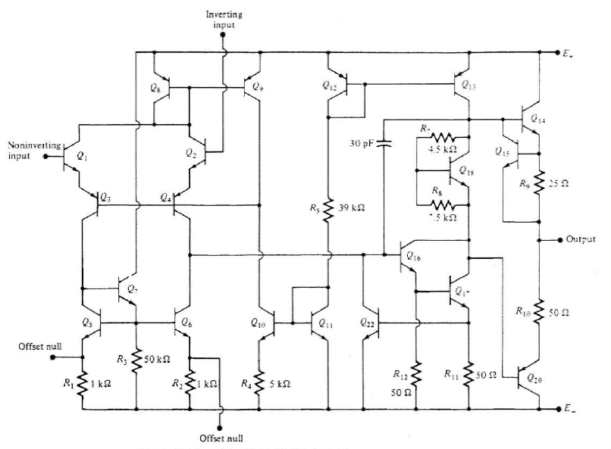
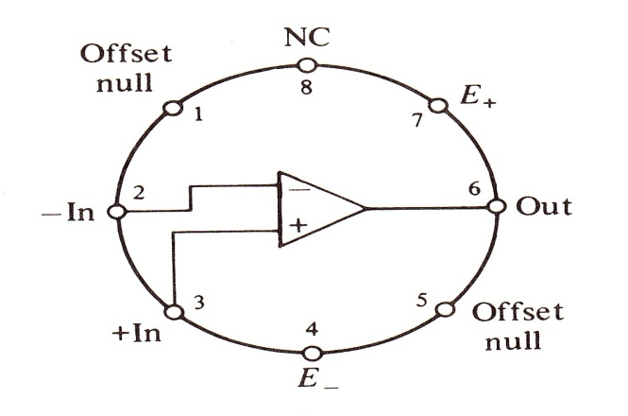
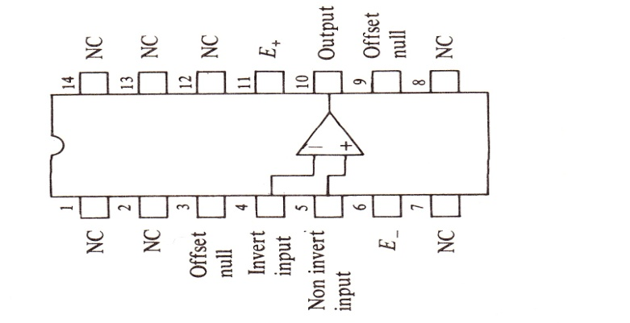

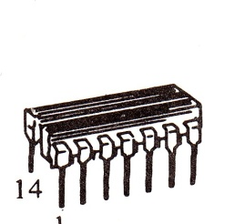
Operational Amplifier (Op-Amp)
L.O. Chua, C.A. Desoer, S.E. Kuh. “Linear and Nonlinear Circuits”, Mc.Graw Hill, 1987, New York

Slide 2
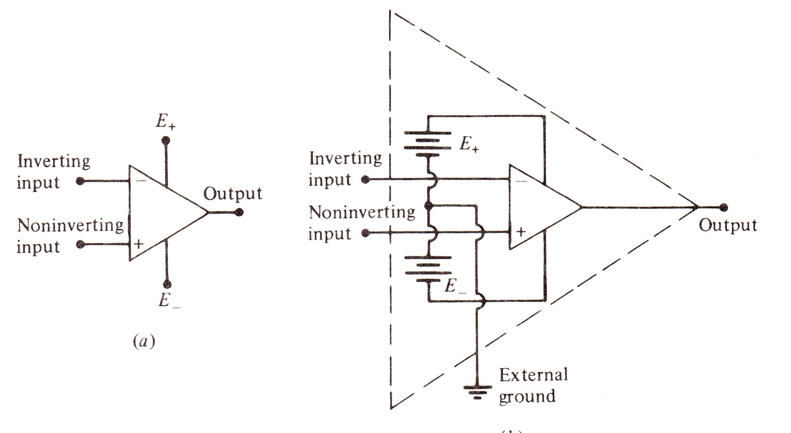
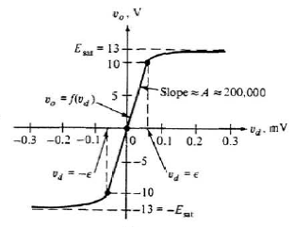
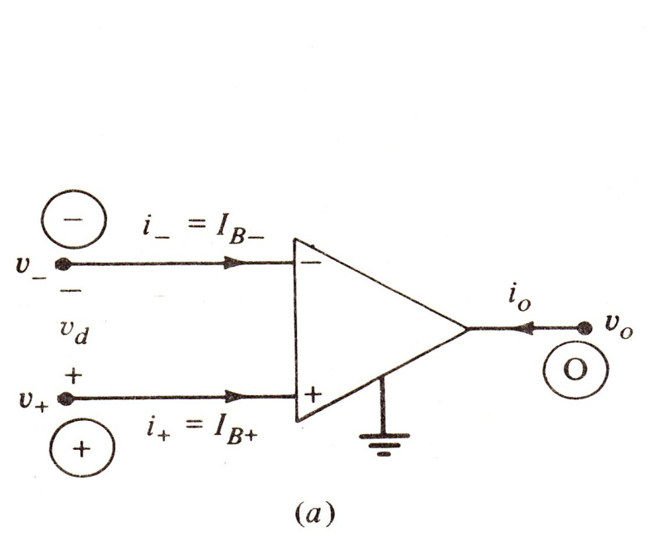
n
o
p
How many terminals does it have?
How many equations do we need?
Base currents
Bipolar (µA741)
FET (µA740)
~0,2mA
~0,1nA
L.O. Chua, C.A. Desoer, S.E. Kuh. “Linear and Nonlinear Circuits”, Mc.Graw Hill, 1987, New York
Notes:
İşlemsel kuvvetlendirici tanım bağıntısı ve ornek devreler eksik

Slide 3
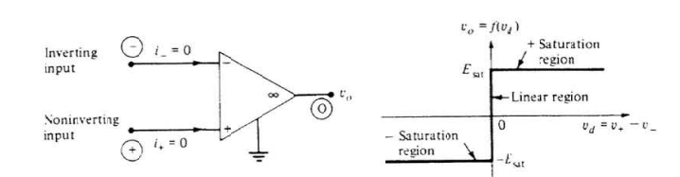
Ideal Op-Amp
-
V_{d}
₊
L.O. Chua, C.A. Desoer, S.E. Kuh. “Linear and Nonlinear Circuits”, Mc.Graw Hill, 1987, New York

Slide 4
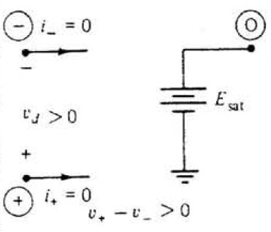
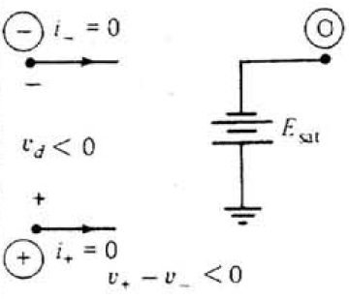
Equivalent model for positive saturation region
Equivalent model for negative saturation region

Slide 5
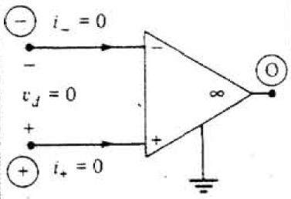
Equivalent model for linear region
Hayali
kısa-devre

Slide 6
Negative-Positive Feedback Circuits
+
-
+
-
+
-
+
-
i_{o}
i_{o}
v_{d}
v_{d}
+
v_{o}
+
v_{o}
+
v_{in}
+
v_{in}
-
-
Linear Region:
Negative Feedboack
Positive Feedback

Slide 7
+ Saturation Region
Negative Feedback
Positive Feedback
i_{n}
i_{p}
+
-
+
v_{o}
+
-
+
v_{o}
v_{d} > 0
+
E_{sat}
v_{d} > 0
+
E_{sat}
i_{p}
i_{n}
+
v_{in}
+
v_{in}

Slide 8
- Saturation Region
Negative Feedback
Positive Feedback
i_{n}
i_{p}
+
-
+
v_{o}
+
-
+
v_{o}
v_{d} < 0
-
E_{sat}
v_{d} < 0
-
E_{sat}
i_{p}
i_{n}
+
v_{in}
+
v_{in}

Slide 9
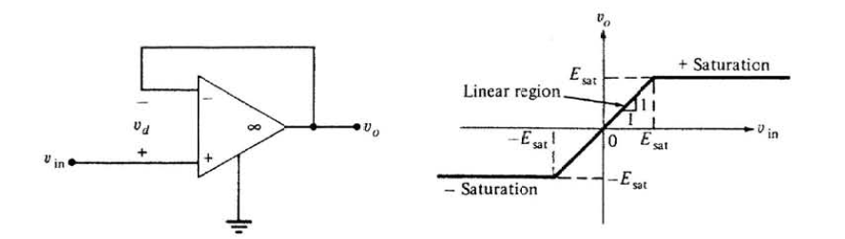
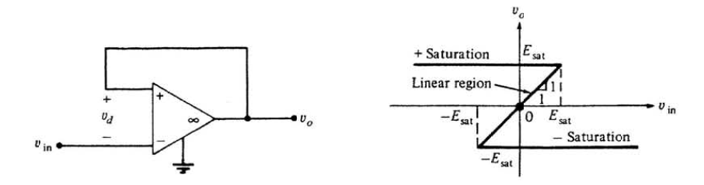
Negative Feedback Circuit
Positive Feedback Circuit

Slide 10
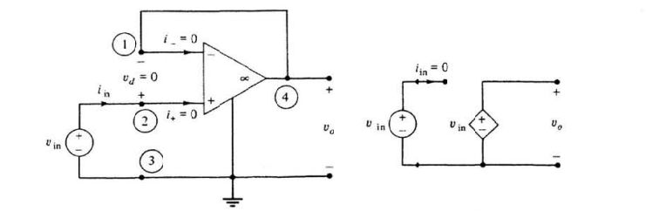
Some Applications
Buffer
Aim: No matter how big is the load at the output, the output voltage is the same as the input voltage.
Voltage-controlled voltage source
valid for

Slide 11
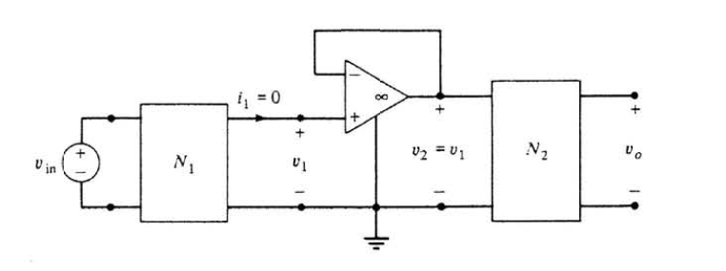
Some Applications
Buffer
Aim: No matter how big is the load at the output, the output voltage is the same as the input voltage.
Internal resistance is large for the input and small for the output.
This reduces the downloading effect of N₂ onto N₁.
Simple analysis.

Slide 12
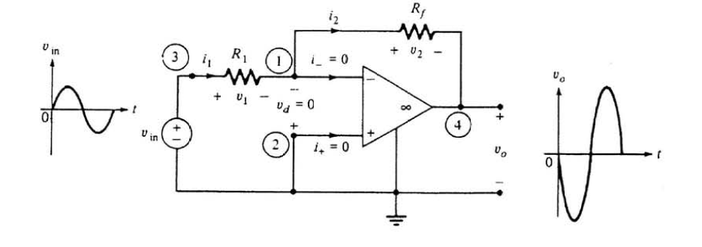
Some Applications
Inverting Amplifier
Aim: A signal with small amplitude at the input is amplified at the output with a 180 degree phase shift.
valid for

Slide 13
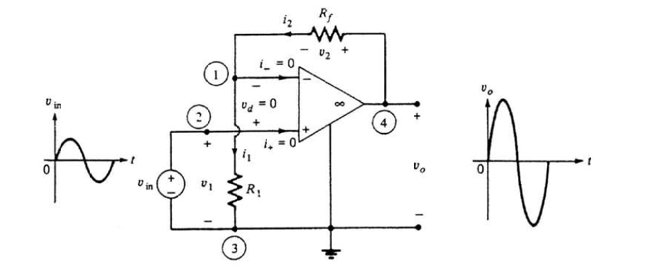
Some Applications
Non-inverting Amplifier
Aim: A signal with small amplitude at the input is amplified at the output without any phase shift.
valid for

Slide 14
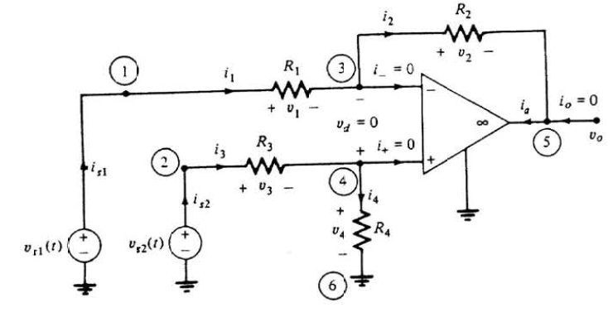
Some Applications
Differential Amplifier
Aim: Difference between two signals at the input is amplified at the output.
valid for

